Slide 1
Bank Analytics
By Akash Gupta.

Slide 2
Project : Debit & Credit Dashboard
Project Goal
To analyze and visualize debit and credit transactions across different banks and branches to monitor account activities, compare performance, and identify transaction trends.
Introduction
This dashboard provides a monthly overview of debit and credit performance for multiple banks.
It helps understand key transaction behaviors, customer preferences, and overall financial activity in an easy-to-read visual format.

Slide 3
Dataset Description
Data Source:
Bank transaction data collected from multiple branches and banks.
Data Cleaning :
First I have get Raw Dataset and Cleaning Process is done in Excel
So in Cleaning Process I have get Almost Clean Data so In This Data I have Just Change Data Type of Column Amount in text to Decimal And Transaction Date in Date/time converted into Date.
Then I have convert this this Excel File into CSV File.
SQL:
I have Import this CSV File in SQL WORKBENCH in SQL WORKBENCH I Have Performed KPI in that I have write a Syntax to see the Values of that KPI.
KPI I have Performed in SQL Workbench
. Total Credit Amount
. Total Debit Amount
. Account Activity Ratio
. Net Transaction Amount
. Credit & Debit Ratio

Slide 4
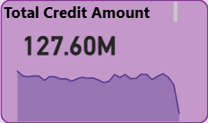
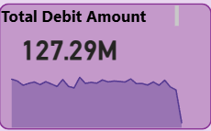
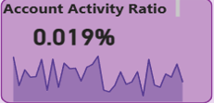
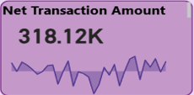
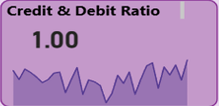
Key Performance Indicators (KPIs)
1. Total Credit Amount: ₹127.60M
Shows the Total Value of Credit Transaction Made, Highlighting the Overall Funds extended or Credited to Customer During in Period.
2. Total Debit Amount: ₹127.29M
Indicates the Total Amount Debited from Customer Accounts, Reflecting Overall Payments Withdrawal's or Outgoing Financial Transaction
3. Account Activity Ratio: 0.019%
This KPI is Showing Customer Engagement through Transaction Activity
4. Net Transaction Amount: ₹318.12K
Represent the Overall Net Value after offsetting Total Debits against Credit, reflecting the Organization’s Actual Financial Movement or Balance.
5. Credit & Debit Ratio: 1.00
Represents the proportion between Total Credit and Debit Amounts, Indicating a nearly Balanced Financial Flow with Slightly Higher Credit Activity.

Slide 5
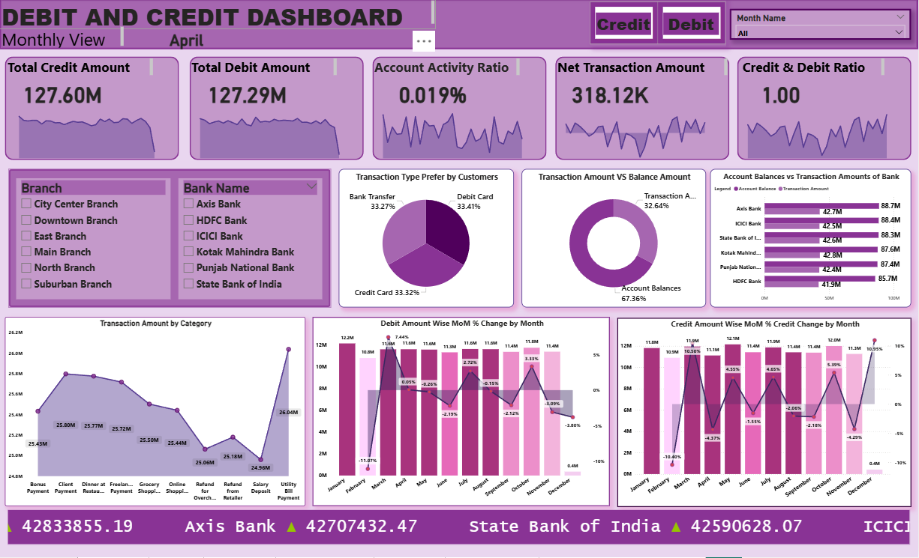
Dashboard Overview

Slide 6
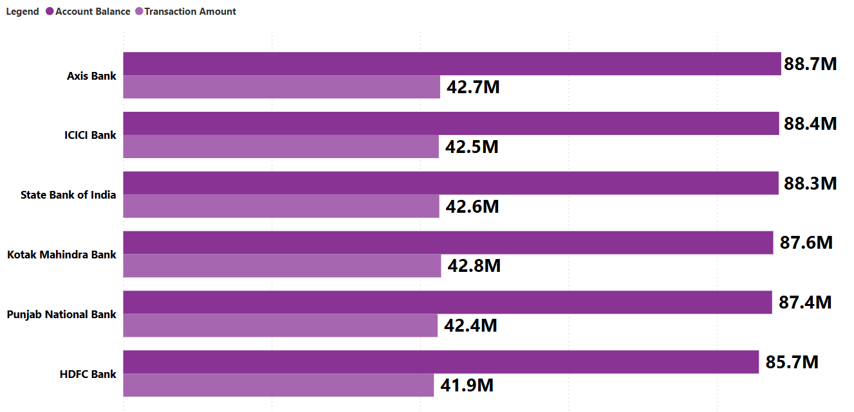
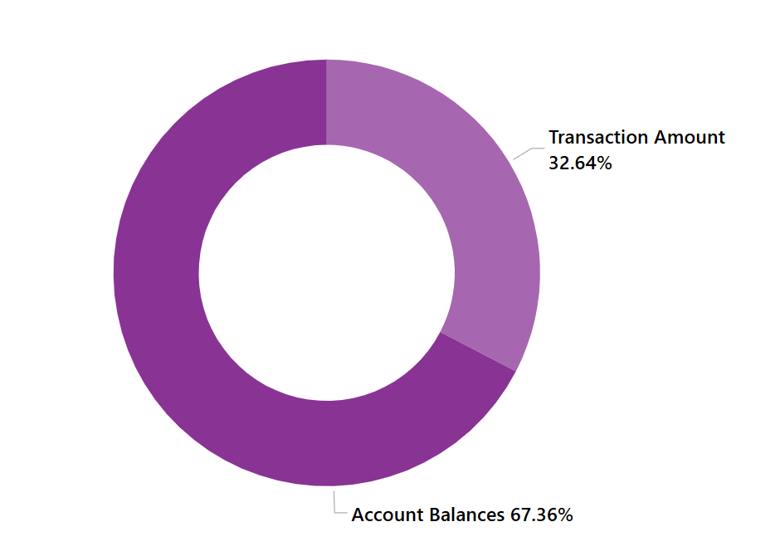
Visual Insights:
1.Account Balances vs Transaction Amounts of Bank
Branch & Bank Analysis:
Filters available for Branch and Bank Name to view specific insights.
Axis Bank, ICICI Bank, and HDFC Bank show high transaction activity.
Punjab National Bank and Kotak Mahindra Bank follow closely.

Slide 7
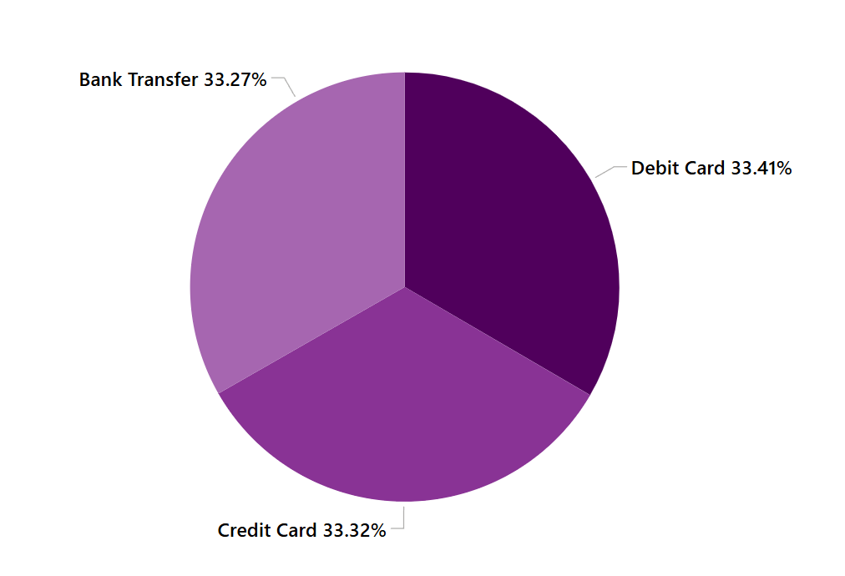
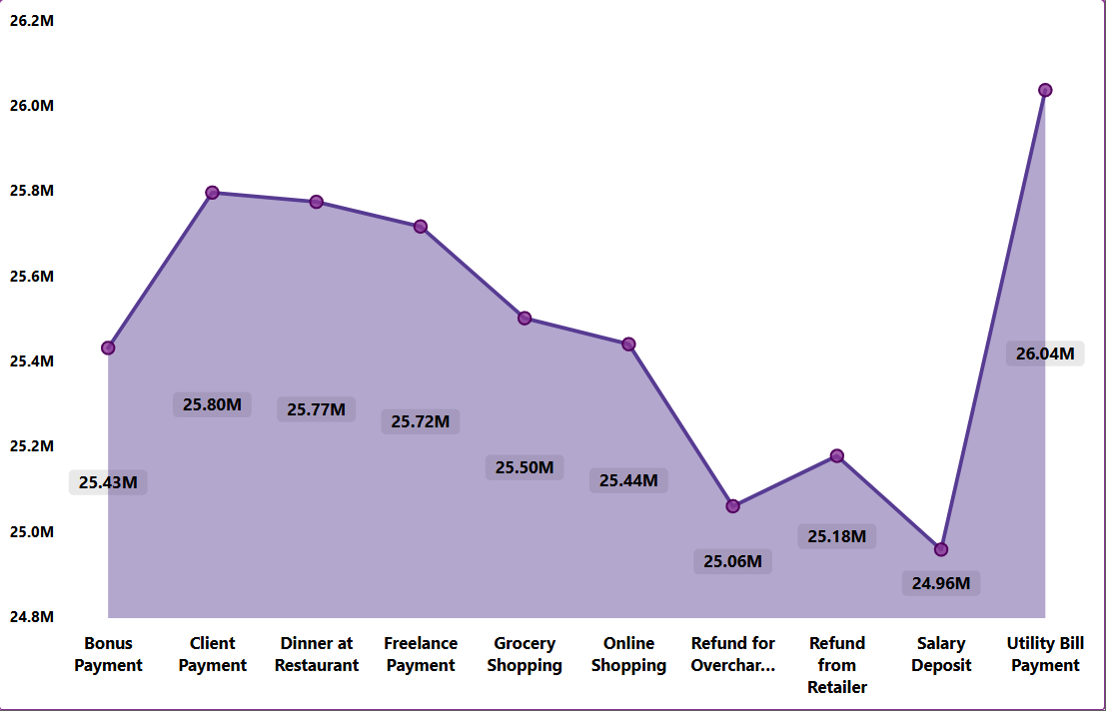
Visual Insights:
2. Transaction Type Prefer by Customers
3. Transaction Amount by Category
This Pie Chart Highlights The Most Frequently used of Transaction types by Customers. Providing Insights into user preference and Banking Behavior Trends
Pie Chart: Shows customer preference for transaction types — Debit Card (33.41%) slightly higher than Bank Transfer and Credit Card.
This Area Chart shows the Total Value of Transactions Grouped by Category Helping to Identify which Categories Contributes Most to Overall Financial Activity.
With the Help of Filter we can see Each Bank and there Branch Wise Transaction Amount by Category

Slide 8
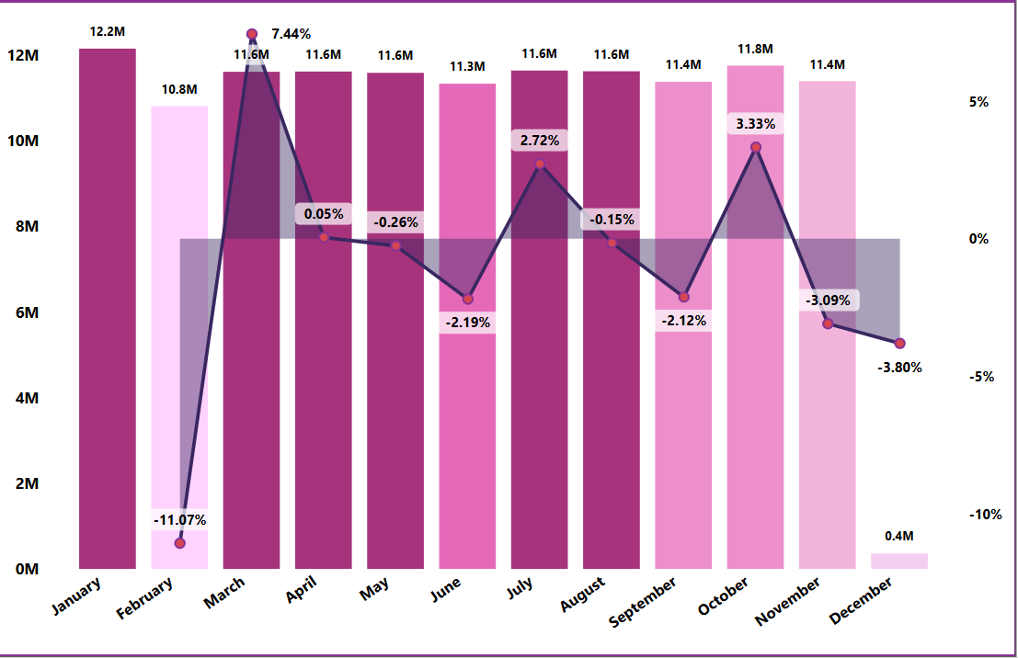
4.Debit Amount Wise MoM % Change by Month
What This Chart Shows:
This visual compares the Monthly Debit Amounts (bars) with their Month-over-Month (MoM) percentage change (line) throughout the year.
Bars (Purple Columns): Represent the Total Debit Amount in millions (M) for each month.
Line (With % Labels): Shows how much the Debit amount increased or decreased compared to the previous month (Month-over-Month change).
🔹 Easy Explanation of the Trend:
January → February:
Debit amount dropped sharply from 12.2M to 10.8M → -11.07% decrease.
➤ Indicates lower debit activity in February.
February → March:
Sharp recovery — debit amount rose to 11.6M → +7.44% increase.
➤ Customers became more active again.
April to June:
Debit amount remained steady (around 11.6M), with small changes (0.05% to -2.19%).
➤ Shows stable debit trends during mid-year.
July to October:
Small ups and downs — slight increases in July (+2.72%) and October (+3.33%),
but minor drops in August (-0.15%) and September (-2.12%).
➤ Indicates moderate activity fluctuations.
November → December:
Noticeable decline (-3.09% and -3.80%), and amount dropped to just 0.4M in December.
➤ Possible reason: year-end account settlements or fewer transactions.
🔹 Key Insights:
✅ Debit transactions were highest in January and March.
✅ Mid-year remained steady without major spikes or drops.
✅ End of the year (Nov–Dec) saw a decline in debit transactions.
✅ Overall, debit performance was stable with minor month-to-month variations.

Slide 9
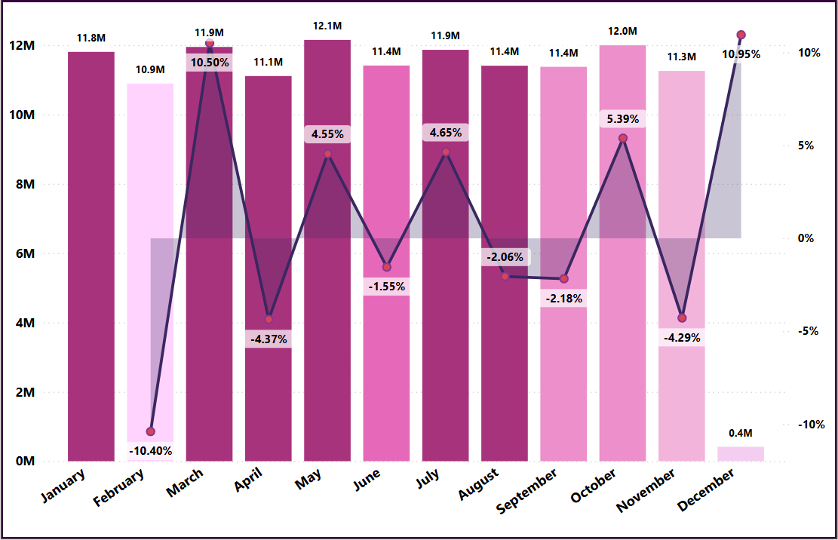
5.Credit Amount Wise MoM % Change by Month
What This Chart Shows:
This visual compares the Monthly Credit Amounts (bars) with their Month-over-Month (MoM) percentage change (line) throughout the year.
Bars (Purple Columns): Represent the Total Credit Amount in millions (M) for each month.
Line (With % Labels): Shows how much the Credit amount increased or decreased compared to the previous month (Month-over-Month change).
🔹 Step-by-Step Trend Explanation:
January → February:
Credit amount dropped from 11.8M to 10.9M, showing a -10.40% decrease.
➤ Indicates a fall in credit transactions at the start of the year.
February → March:
Credit amount rose sharply to 11.9M, a +10.50% increase.
➤ Customers became more active in credit usage again.
April → May:
A small decline of -4.37%, but amount remained around 11.1M, showing minor fluctuation.
May → July:
  June: Slight fall of -1.55%
  July: Strong recovery with +4.65% growth
  ➤ Indicates moderate recovery in mid-year.
August → September:
Slight decline again (-2.06% to -2.18%) → showing stability with small drops.
October:
Positive growth of +5.39%, reaching around 12.0M, the second-highest value of the year.
November → December:
  November: Drop of -4.29%
  December: Sharp increase of +10.95%, closing the year strongly.
  ➤ Indicates an end-of-year rise in credit activity (possibly festive or bonus-related).
🔹 Key Insights:
✅ Highest growth months: March (+10.5%) and December (+10.95%)
✅ Lowest performance: February (-10.40%)
✅ Mid-year (May–September): Mostly stable with small variations.
✅ Overall: The year ended positively, showing recovery and increased credit activity.

Slide 10
Conclusion
Both Credit and Debit values are nearly equal, showing stable financial performance.
The Bank is a High-Volume Transfer Service with No-Saving Growth
So we need to Focus on Converting those Customers who get their Salary (Credit) and then Spend it all (Debit) into Savers.
Recommendation
Encourage customers to use digital transactions to improve the activity ratio.
Focus on promoting debit and credit card rewards to enhance usage frequency.
Monitor branches with low performance and plan targeted marketing campaigns.
We have to Offer New-High-Interest Saving or Fixed Deposits Accounts to Convince the Customers to Leave the Money in the Bank Instead of Transferring it Out.

Slide 11
Project : Bank Loan Dashboard
Project Goal
To Analyze and Track bank Loan Performance, Collections, and Customer Insights for Better Financial Decision-Making.
Introduction
This Dashboard provides a Monthly and Yearly View of Loan-Funded Amounts, Collection Trends, Customer Preferences, and Loan Performance across different states and categories.

Slide 12
Dataset Description
Data Source:
Bank Loan Dashboard.
Data Cleaning :
First I have get Raw Dataset and Cleaning Process is done in Excel
So in Cleaning Process I have get Almost Clean Data so In This Data I have check there is No Duplicate Value or Null Value is there and some Blank value is there in this Data so I Have Removed it.
Then I have converted this this Excel File into CSV File.
SQL:
I have Import this CSV File in SQL WORKBENCH in SQL WORKBENCH I Have Performed KPI in that I have write a Syntax to see the Values of that KPI.
KPI I have Performed in SQL Workbench
. Total Loan Funded Amount
. Total Collection Amount
. Total Interest Value
. Total Loans

Slide 13
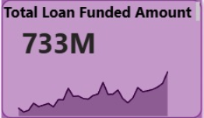
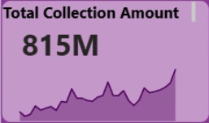
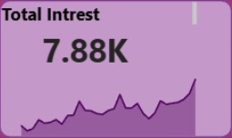
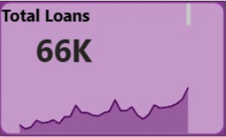
Key Performance Indicators (KPIs)
1. Total Loan Funded Amount: ₹733M
Here in this KPI is telling Bank has issued a Large Amount of Money in Loan ₹ 733M
2. Total Collection Amount: ₹815M
So, this is a Good Sign from this KPI The Bank is Collected a Little More Money than the Loan Amount Funded. So, the Total Collection Amount ₹815M
3. Total Interest Value: ₹7.88K
So Total Interest Fees Bank is getting ₹7.88K
4. Total Loans: ₹66K
This KPI is Indicates that 66K Issued Customer they have taken a Loan From Bank.

Slide 14
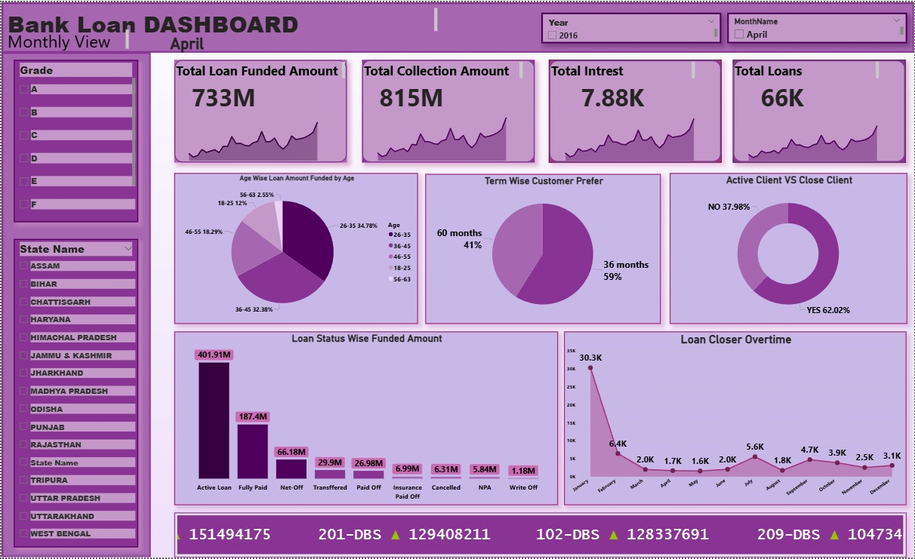
Dashboard Overview

Slide 15
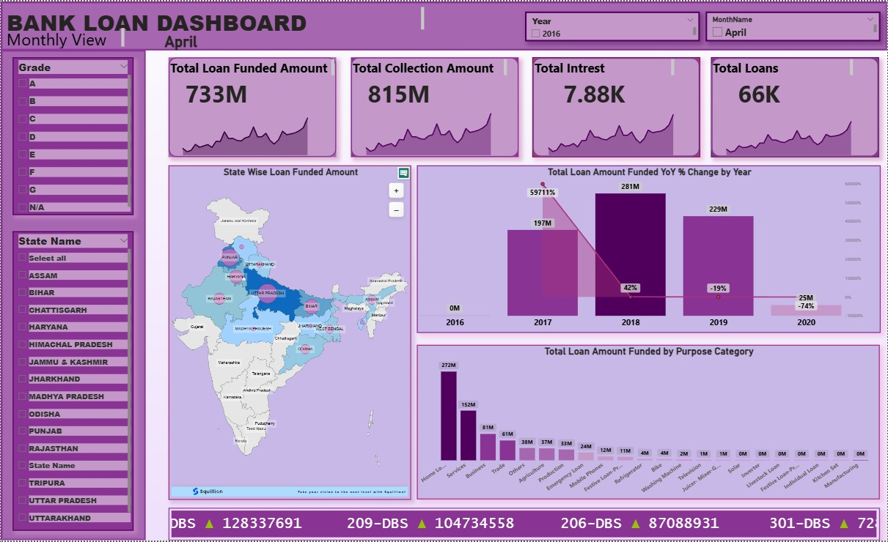

Slide 16
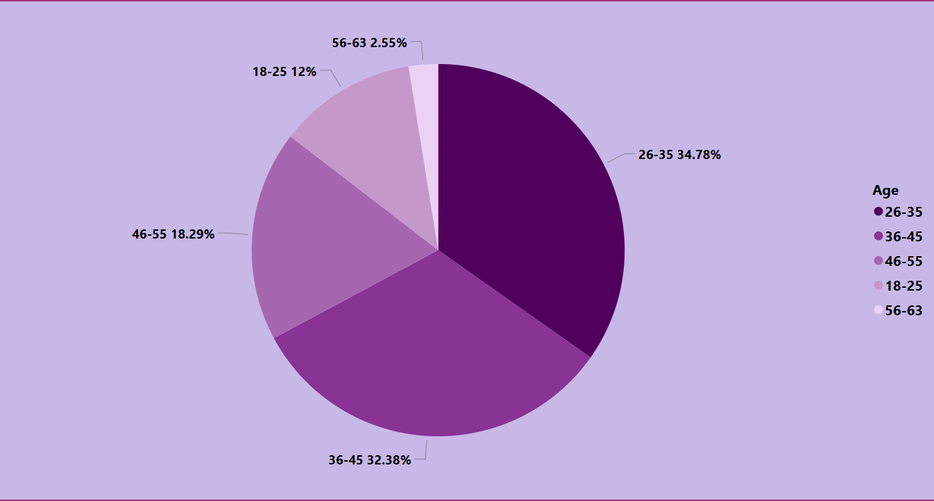
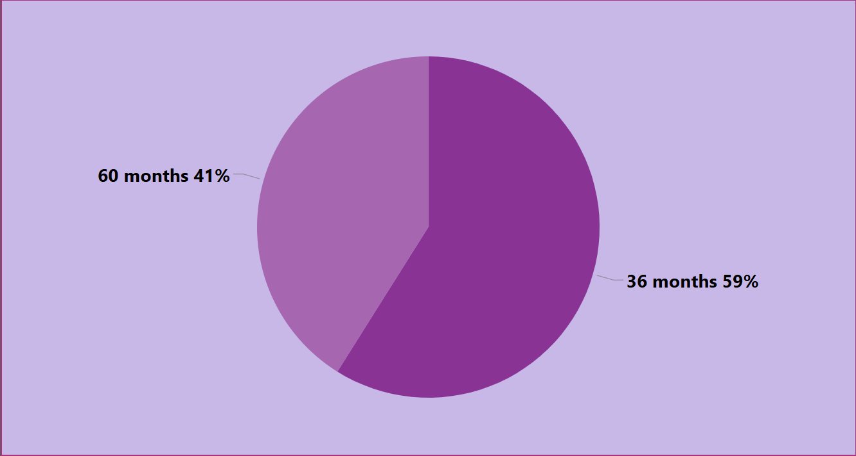
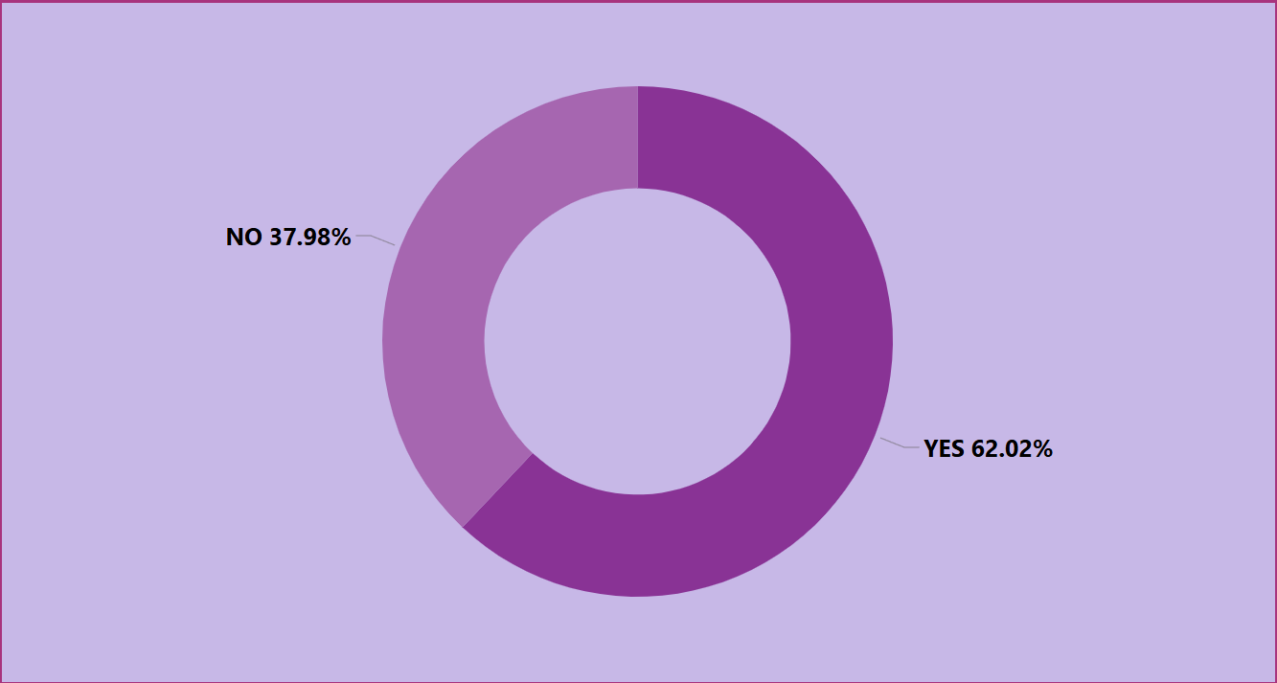
Visual Insights:
1. Age – Wise Loan Funded Amount Distributed
2. Term Wise Customers
3. Active Client VS Close Client
This Pie Chart Highlights that Loan Amount Distributed Across Different Age Groups, helping to identify which age Segments Contribute Most to Lending Activity.
Pie Chart: Shows Highest loan funded in age group 26–35 years (34.78%).
This Pie Chart Analyze Customer Preference's for Short – term Versus Long Term Loan.
Pie Chart: Shows Highest Most customers prefer 36 months (59%) loan term.
This Pie Chart show in each States wise Active Client and Close Client.
Pie Chart: Shows Highest Active Loans: 401.91M (Highest).

Slide 17
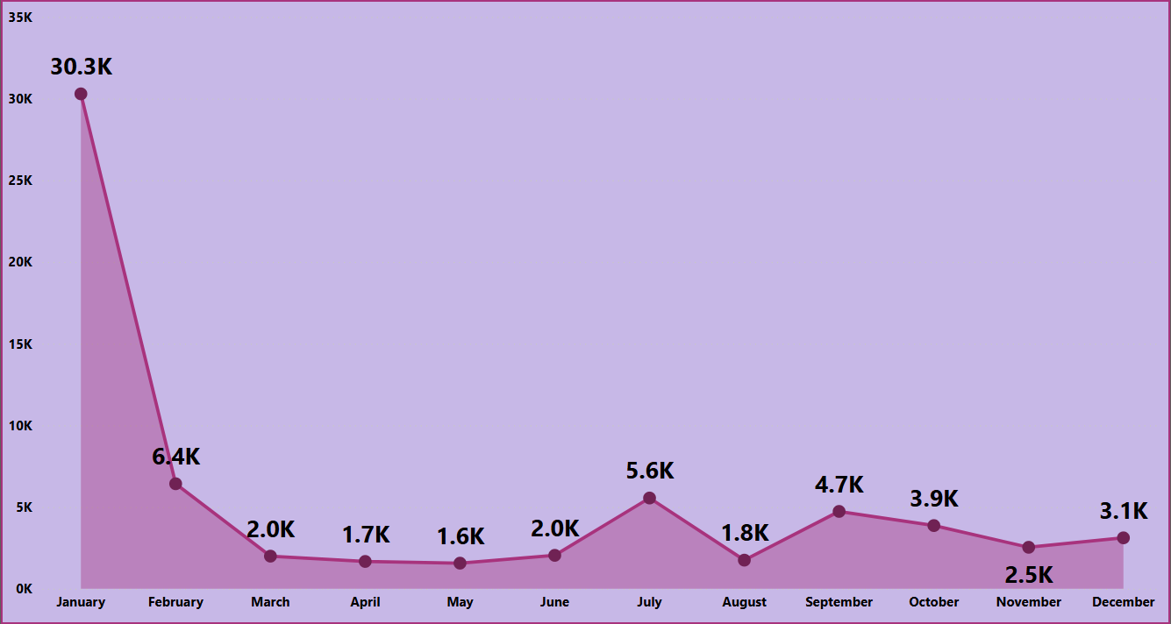
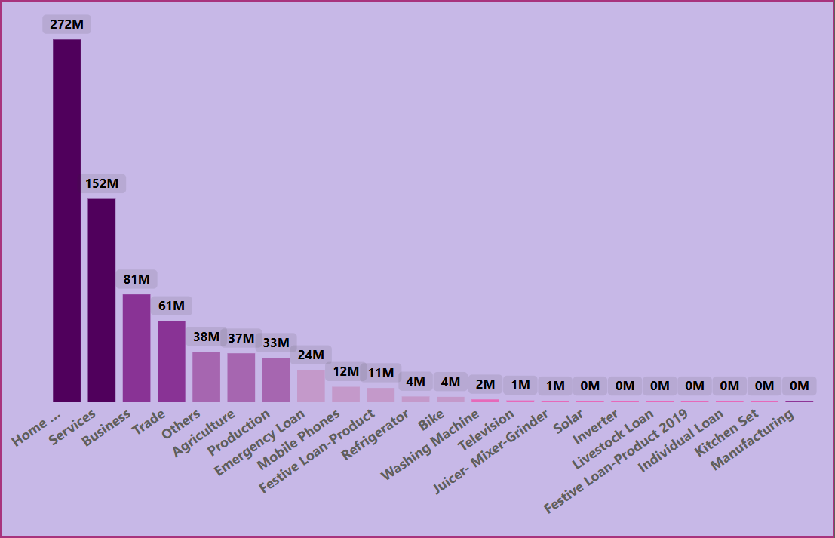
Visual Insights:
4. Loan Closure Overtime
4. Total Loan Amount Funded by Purpose Category
This Line Chart Represents the Number or Value of Loan Closed During Specific Time Periods helping to Track Repayments trends and Borrower Behavior Overtime
This Bar Chart Represents the Total Loan Amount Distributed For Loan Purpose, Helping to Identify Which Loan Categories Contribute Most to Overall Lending

Slide 18
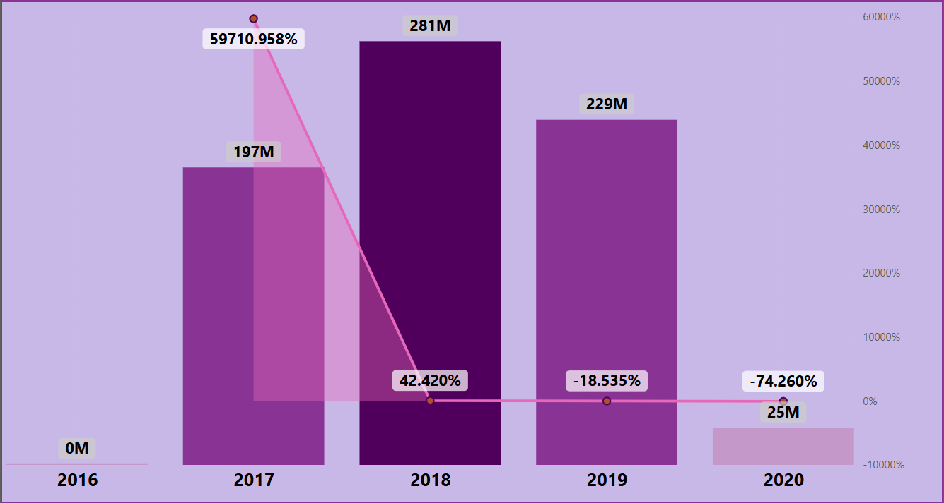
6. Total Loan Amount Funded YoY % Change by Year
🔹 What This Chart Shows:
This visual compares the total loan amount funded each year (bars) with the Year-over-Year (YoY) percentage change (line) from 2016 to 2020.
Bars (Purple Columns): Represent the total loan amount funded (in millions) for each year.
Line (With % Labels): Shows how much the loan amount increased or decreased compared to the previous year.
Explanation of the Trend:
2016:
No loans were funded (0M) — this is the base year.
2017:
Loan funding jumped to 197M, showing a huge YoY growth of 59,710.96%.
➤ This was a major growth year as lending operations began strongly.
2018:
Loan amount increased further to 281M, marking a +42.42% growth from 2017.
➤ Indicates continued expansion in loan distribution.
2019:
Slight decline to 229M, a -18.53% decrease.
➤ Possible reason: tighter credit checks or reduced loan demand.
2020:
Sharp drop to 25M, a -74.26% decline from the previous year.
➤ Likely due to external factors such as economic slowdown or stricter funding criteria (possibly pandemic effect).
🔹 Key Insights:
✅ Strong Growth (2017–2018): Rapid expansion in loan disbursement.
⚠️ Decline After 2018: Loan amounts started decreasing from 2019 onwards.
📉 2020 Sharp Fall: Major drop, showing the lowest loan funding in five years.

Slide 19
Conclusion
Bank’s main customers are young adults (26–35 age group).
Short-term (36 months) loans are most popular.
Active loans and home loans dominate the portfolio.
Collections have improved over time but declined slightly after 2018.
Certain states are driving most of the loan growth.
Recommendation
✅ Focus on the 26–35 age group with special loan offers.
Most loans are taken by this age group, so the bank should give them special offers and Plans.
✅ Promote home and personal loans as they are most in demand.
These are the most popular loan types, so increasing schemes in these areas can grow the business.
✅ Strengthen collection process in weak-performing regions.
Some states have low collections. The bank should make better plans to collect money on time.
✅ Track yearly loan performance to maintain growth.
The loan growth was high in 2018 but dropped later, so regular monitoring can help improve future
Performance.
✅ Provide customer retention plans to reduce loan closures.
Give good service to active clients and help them renew or take new loans instead of closing old
Ones.

Slide 20
Thank You

